Slide 1
Introduction to Binary-State Speciation and Extinction (BiSSE) Model
Chinedum Anajemba

Slide 2
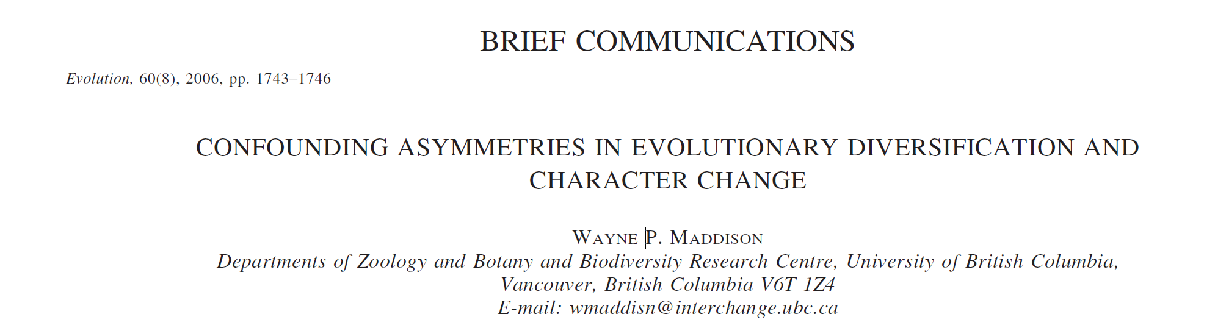

Slide 3
Studies of character evolution often assume that a phylogeny’s shape is determined independently of the characters, which then evolve as mere passengers along the tree’s branches. This is valid if the character of interest is neutral
However, if the characters help shape the tree, but this is not considered, biased inferences can result.

Slide 4
If we treat a character that drives the shape of the tree as if it were merely a passenger on a pre-existing tree, what mistakes of inference could we make?

Slide 5
To address this Question
Phylogenies of 100 species were simulated
The character began at the root of the tree with either state 0 or 1 equiprobably.
Character state change was symmetrical (probability of changing from state 0 to 1 or 1 to 0 is equal) at each time interval
The tree evolved through a pure birth process (each individual in the population independently gives birth at a certain rate), with a speciation rate depending on the character state.
Various combinations of speciation rates were investigated
Simulation continued until 100 species were evolved.

Slide 6
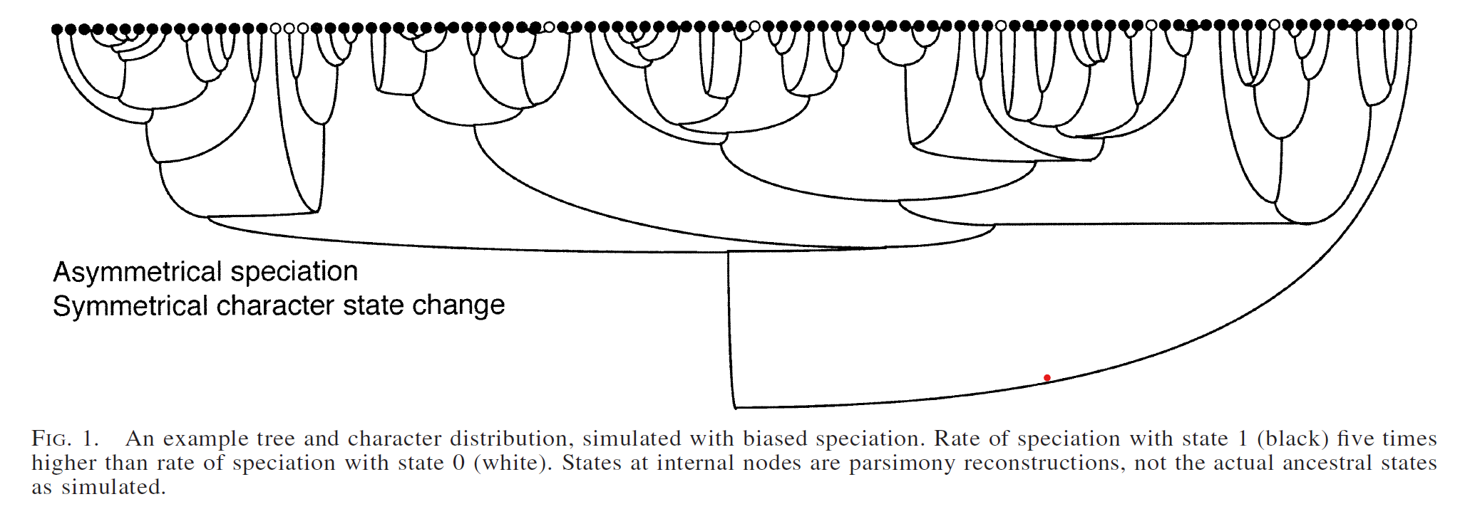
Equal vs Biased speciation
The total number of actual character state changes ranged from about 10 (when speciation was biased) to 50 (when speciation rates were equal).

Slide 7
To interpret the evolution of the character evolved with the tree.
Used the tree to infer whether character change was asymmetrical, that is, whether the rate of gains (0 to 1) is different from the rate of losses (1 to 0).
The maximum likelihood estimate of the bias between gains and losses (the ratio of their respective rates) was calculated

Slide 8
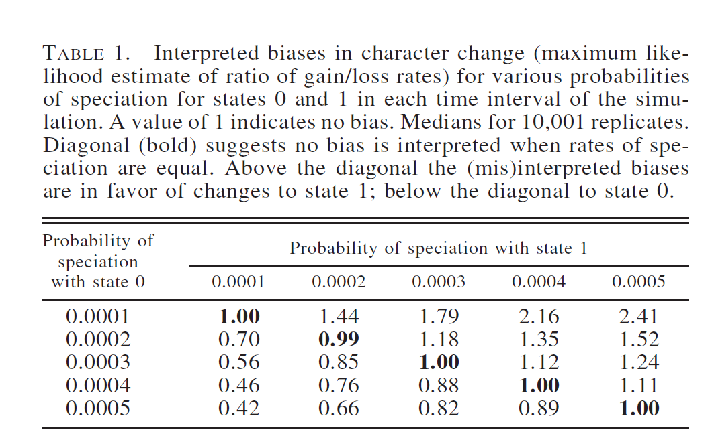
For the replicate shown earlier:
though the character was actually evolved with a bias of 1.0 (i.e., no bias), the characters were interpreted to show biased state change when speciation rates differed.
As expected, as the bias in speciation rates increases, the interpreted bias in character change increases.

Slide 9
A pattern actually due to asymmetry in diversification (speciation more likely under state 1 than 0) will be misinterpreted as due to an asymmetry in character state change (change 0 to 1 at higher rate than 1 to 0).
If the question of interest were whether there existed a bias in character state change, then biased diversification could mislead.

Slide 10
Why was the median presented instead of the sample means on the table?
(Medians are presented instead of sample means, because the latter are strongly influenced by a few replicates of interpreted biases greater than 1000, probably due to flat likelihood surfaces causing problems for the likelihood estimator.)

Slide 11
What if a biologist were studying asymmetries in the rates of species diversification and assumed character state change were symmetrical? What mistakes could be made if character state change were, in fact, biased?

Slide 12
To address this Question
Phylogenies of 500 species were simulated, with each lineage having an equal probability of speciating at any time (symmetrical speciation)
On each simulated tree, a single character was simulated with biased changes with a rate of 0.4 for gains and 0.1 for losses i.e., a bias or gain/loss ratio of 4.0
State 0 or 1 was assigned at the root in proportion to the equilibrium frequencies implied by the model

Slide 13
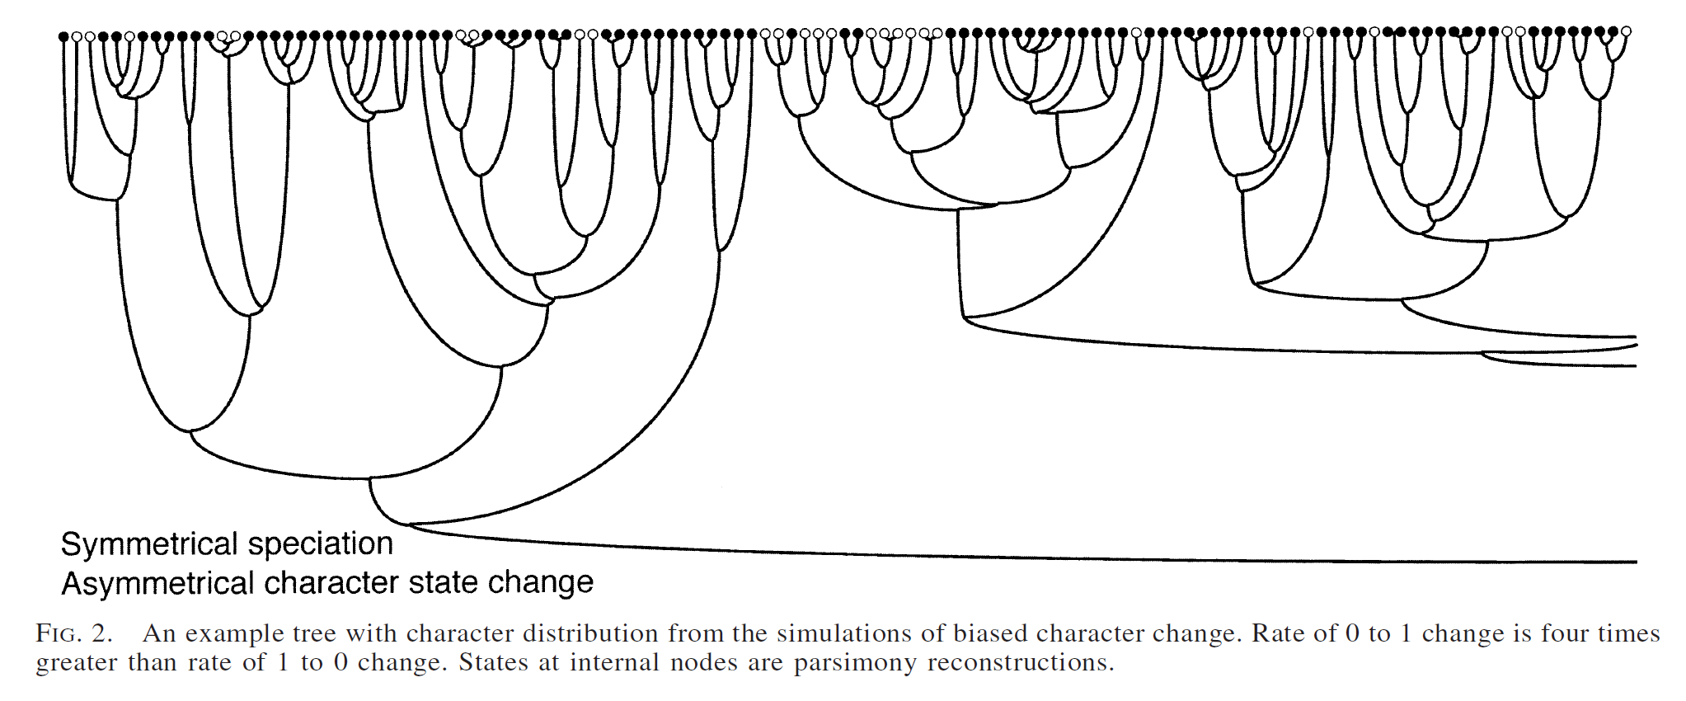
State 1 was common and state 0 was uncommon, scattered throughout the tree, presumably because whenever 0 evolves it tends to revert quickly to state 1.

Slide 14
A simple sister clade method for asymmetrical diversification was used to analyze the trees and their respective characters
Only pairs of sister clades differing in number of species were examined, and were scored as to whether they favored state 1 or state 0.
Then , the hypothesis that clades with state 0 are, in general, at least as large as those with state 1.
In 319 of the 1000 replicates, the null hypothesis was rejected. i.e., clades with state 1 were interpreted to have had greater diversification success. However, when the bias of gains to losses was simulated as 1(i.e., no bias), the null hypothesis was rejected in only 36 replicates

Slide 15
So, a pattern due to an asymmetry in character state change is being frequently misinterpreted as due to an asymmetry in diversification rates.

Slide 16
In summary, asymmetries in both character change and diversification can leave one state rare.
inferences about character state transitions based on simple transition models can be thrown off if the character affects rates of speciation [or extinction]
inferences about whether a character affects lineage diversification based on sister clade comparisons can be thrown off if the transition rates are asymmetric
A methods that consider jointly the biases in diversification and character change are clearly needed

Slide 17
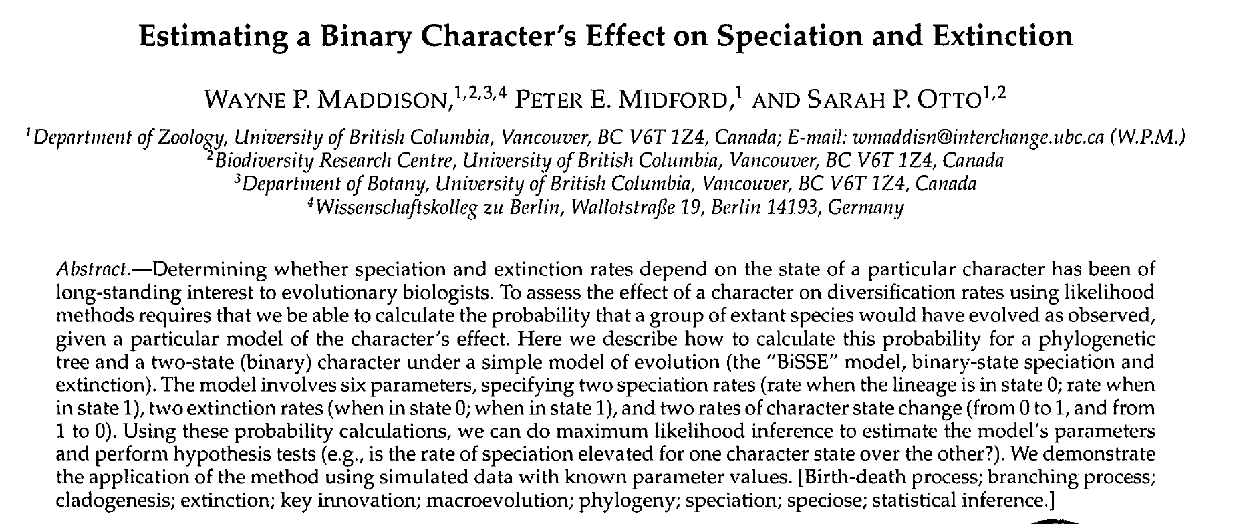

Slide 18
Character’s effect on speciation and extinction
Sister-clade analyses were previously often used.
Has so many drawbacks: Not good for clades with mixed states, considers a subset of the tree, can’t distinguish differential speciation and extinction
Likelihood-based approach is needed, but likelihood calculations for models involving speciation and extinction rates and rates of character state change have been described separately but have not yet been fully integrated.

Slide 19
BiSSE(binary state speciation and extinction ) Model
BiSSE is a model that assesses if the states of a character are associated with different rates of speciation or extinction.
This paper describes how to calculate the probability of the tree and observed states given a basic model with six parameters

Slide 20
BiSSE Model
An accurate rooted phylogenetic tree with branch lengths and the character state known for each of the tips.
The tree is assumed complete
The tree is ultrametric (i.e., the total root-to-tip distance is the same for all tips).
Time is measured backwards, with 0 being the present

Slide 21
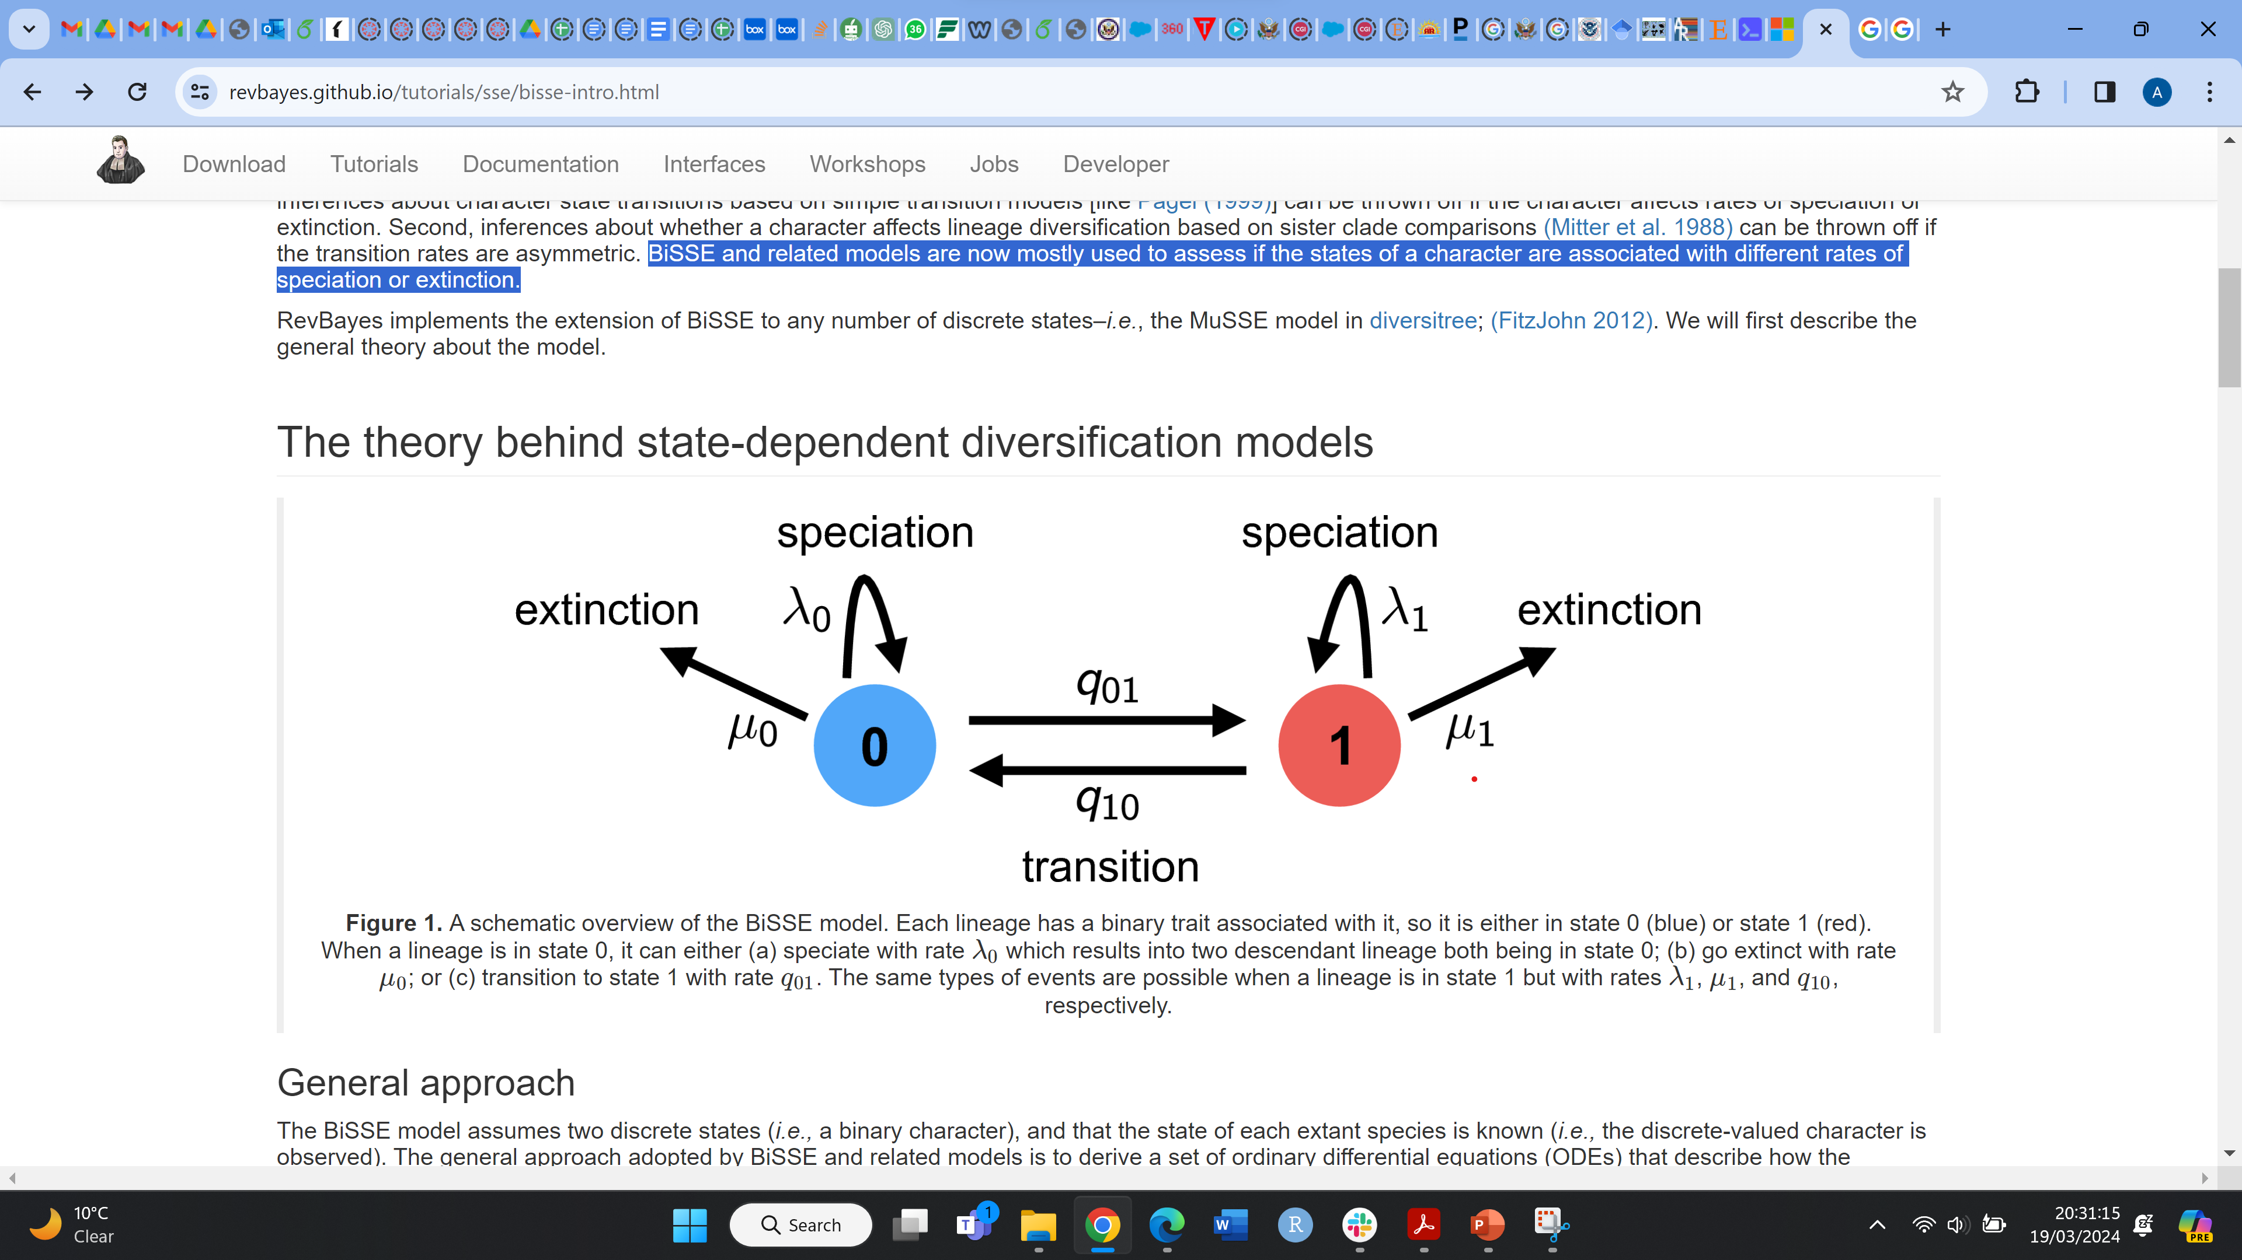
The parameters of the model
These events are independent of one another
Credits to Revbayes tutorial on BiSSE
https://revbayes.github.io/tutorials/sse/bisse-intro.html#Maddison2007

Slide 22
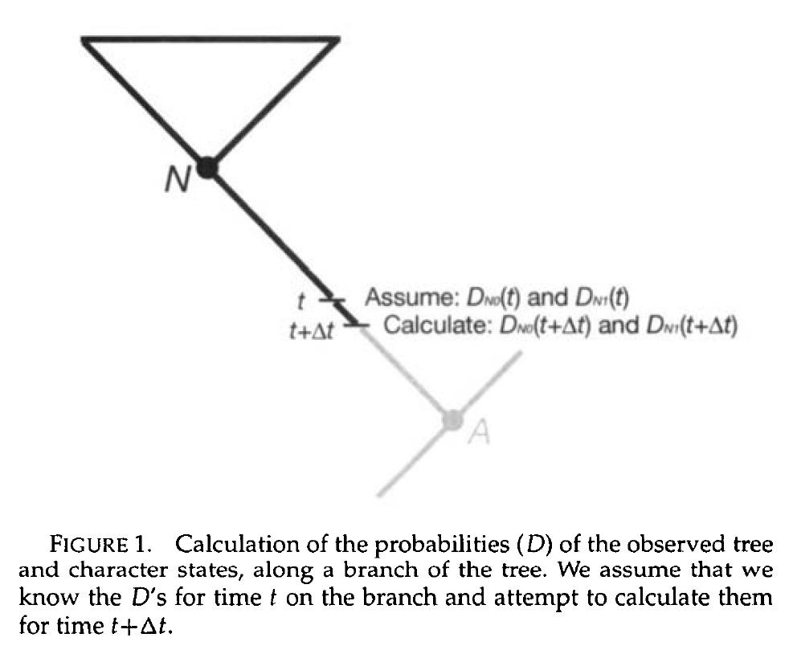
Clade probabilities, DNi
The key probabilities DN,0(t) or DN,1(t), describe the chance that a lineage beginning at time t with state 0 or 1 would evolve into a clade like that observed to have descended from node N, closer to the present. These probabilities are tracked back
by a very short amount of time, Δt

Slide 23
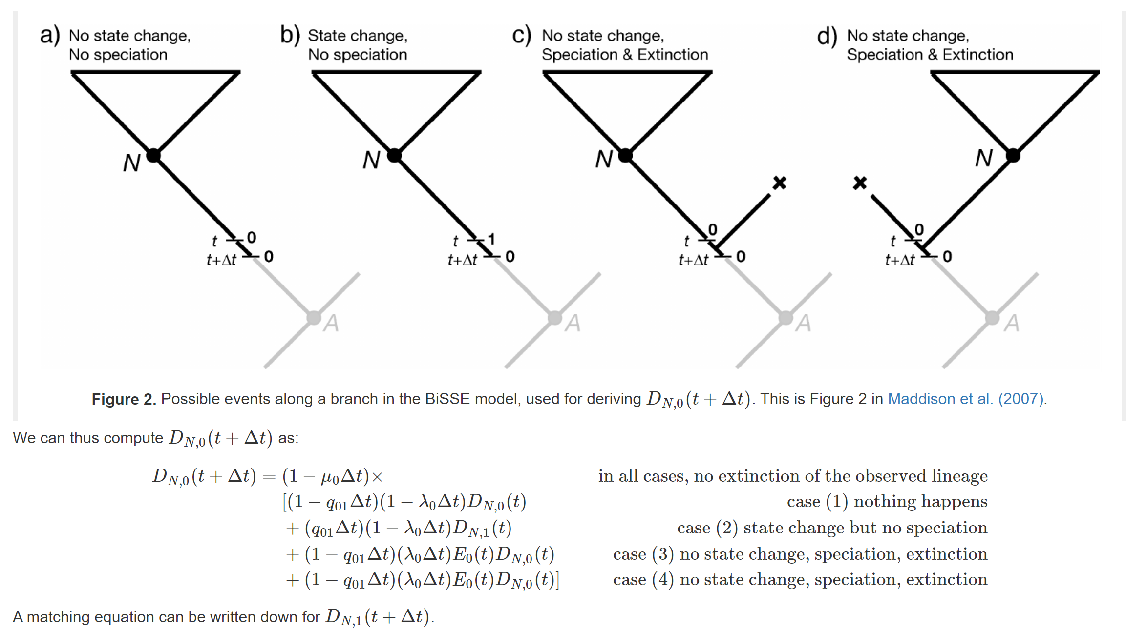
To compute the probability of observing the lineage at some earlier time point, DN,0(t+Δt), we enumerate all possible events that could occur within the interval Δt. Assuming that Δt is small—so that the probability of more than one event occurring in the interval is negligible—there are four possible scenarios within the time interval:
Credits to Revbayes tutorial on BiSSE
https://revbayes.github.io/tutorials/sse/bisse-intro.html#Maddison2007

Slide 24
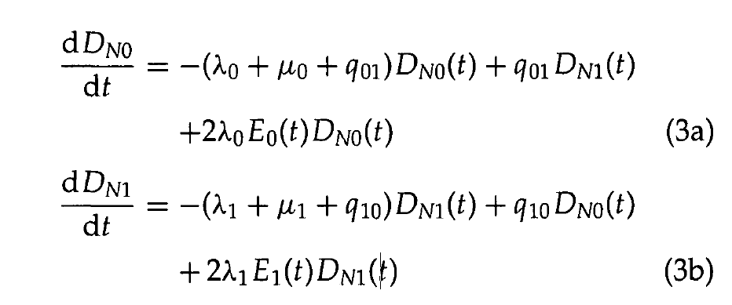
Coupled differential equations are derived by dividing the equations by the time interval Δt while taking the limit as Δt goes to zero.

Slide 25
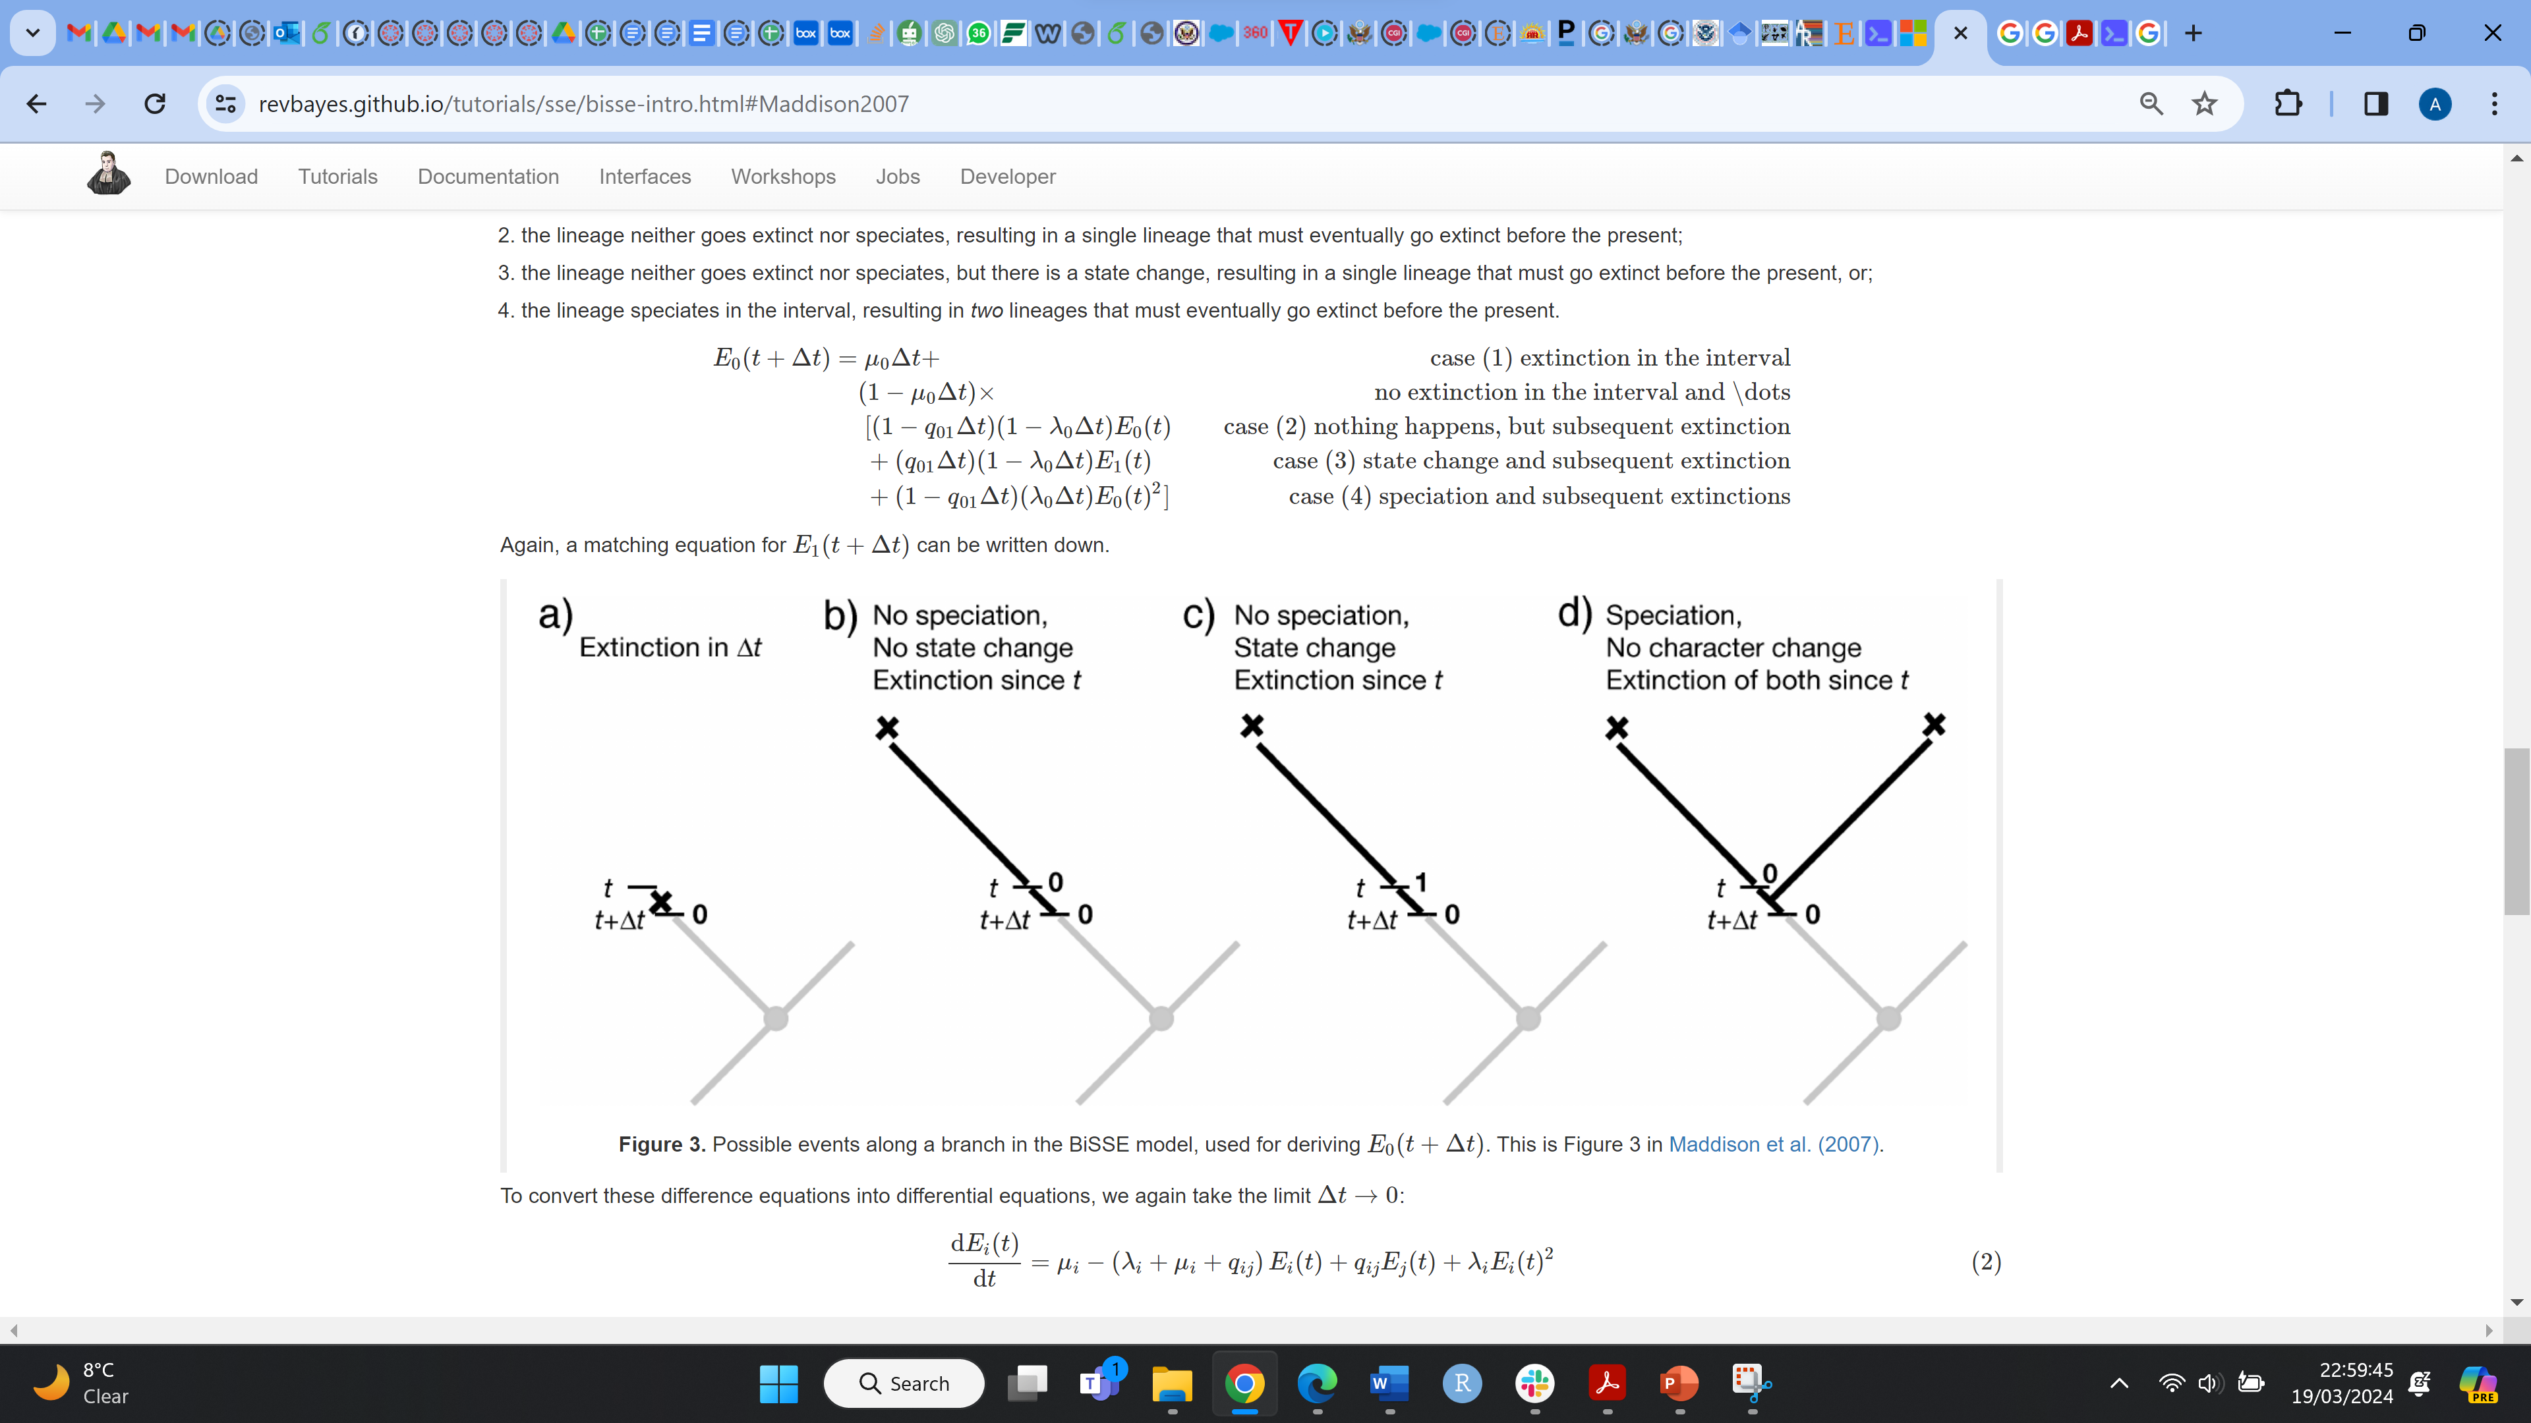
Extinction probabilities, Ei
To solve the Differential Equations (3) DN,0(t) or DN,1(t), we need the extinction probabilities, E0(t) or E1(t). E0(t) or E1(t) is the probability that a lineage in state 0 or 1 at time t goes extinct before the present. To determine the extinction probability at an earlier point, E0(t+Δt), we can again enumerate all the possible events in the interval Δt
Credits to Revbayes tutorial on BiSSE
https://revbayes.github.io/tutorials/sse/bisse-intro.html#Maddison2007

Slide 26
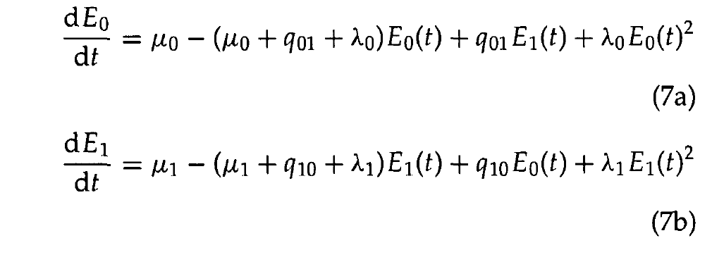
Coupled differential equations are derived

Slide 27
Initial values: tips
These equations describe how to get the answer at time t+Δt assuming we already have the answer at time t.
How do we start this process?
With our character state observations, which are generally the tip state values. If species s has state i, then Ds,i(0)=1 (probability is 1 at time 0 [the present] because we observed it for sure and Ei(0)=0 (probability 0 of being extinct at the present). For the other state than i, Ds,j(0)=0 and Ej(0)=1. we describe how those probabilities change over time, working our way back until we have computed the probabilities of observing that collection of lineages at some earlier time (e.g., the root).
Credits to Revbayes tutorial on BiSSE
https://revbayes.github.io/tutorials/sse/bisse-intro.html#Maddison2007

Slide 28
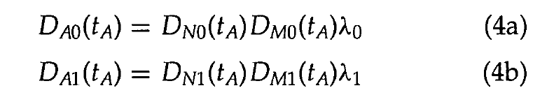
At nodes
Di and Ei are the BiSSE equations describing probabilities along the branches of a phylogeny.
What happens with the clade probabilities (the Ds) at the nodes of the tree?
BiSSE assumes the ancestor (called A) and descendants (called N and M) have the same state (i.e., there is no cladogenetic character change).
The initial value for the ancestral branch going into a node (at time tA) is then the product of the final values for each of the daughter branches coming out of that node, times the instantaneous speciation rate
Credits to Revbayes tutorial on BiSSE
https://revbayes.github.io/tutorials/sse/bisse-intro.html#Maddison2007

Slide 29
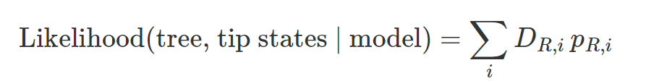
At the root
After we integrate Di and Ei equations from the tips to the root, dealing with nodes along the way, we arrive at the root with the D values (called DR,i), one for each state. These need to be combined somehow to get the overall likelihood of the data:
To obtain a single likelihood, we need to account for the probability that the root was in state 0 or 1. One approach used is to weight these root states by the equilibrium frequencies
of 0 and 1 implicit in the model. There are other approaches that can be used too

Slide 30
This Model can be used to answer questions like:
Is speciation under state 0 more rapid than under state 1?
Is the net diversification rate (speciation— extinction) higher under one state than the other?
What causes an excess of species within one state: asymmetrical character change, asymmetrical extinction, or asymmetrical speciation?

Slide 31
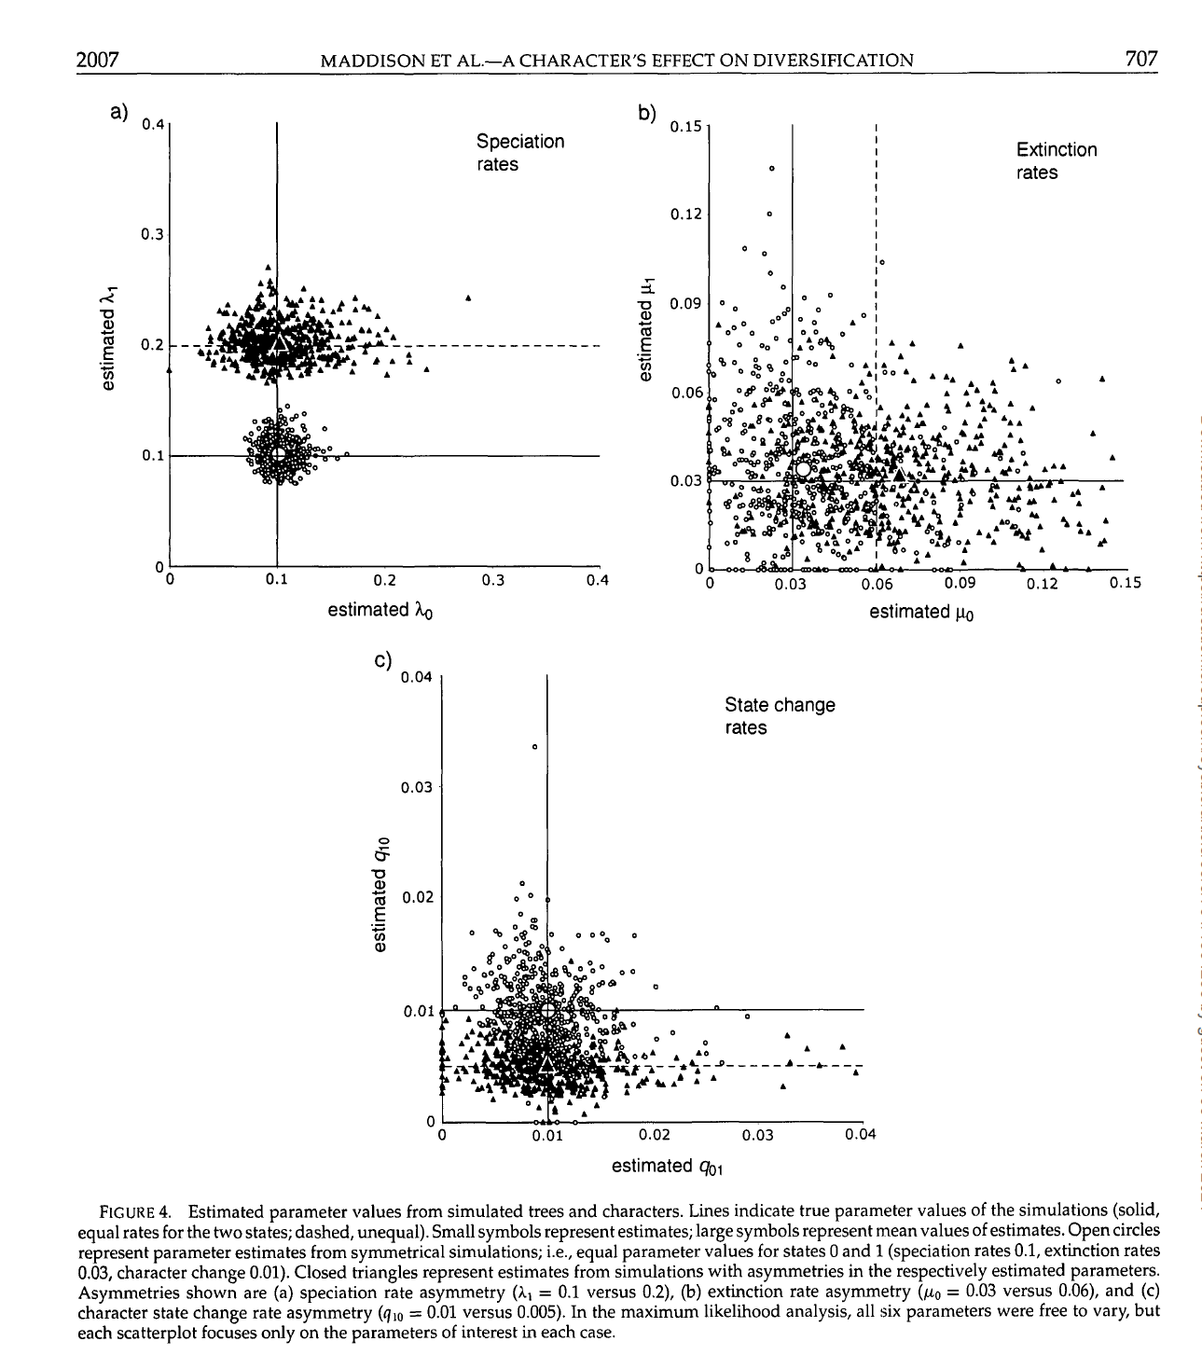
Parameter Estimation:
The estimates of speciation rates λ0 and λ1 are fairly good, falling near the correct parameter values. As well, the estimates for the symmetrical case are easily distinguished from the estimates in the asymmetrical case.
For extinction rates and rates of character state change, the estimates do not so closely match the simulated rates.

